Slide 1

House Price Prediction Challenge
Martin J Page
martin@dsi-program.com
Create a housing price model to valuate residential real estate in Cape Town based on physical characteristics
Notes:
Start by saying that what I decided I wanted to get across in this presentation = whole workflow + the decision made along the way
Then we all know what the task was

Slide 2
The steps involved
1. What data?
  Search property websites
2. Get the data
  Web scaping using scrapy in Python
3. Clean the data
  Python
4. Model the data
  Explore
  Process
  Model and evaluate
Notes:
- Defined the broad steps: finding data, physically getting it, cleaning and modelling

Slide 3

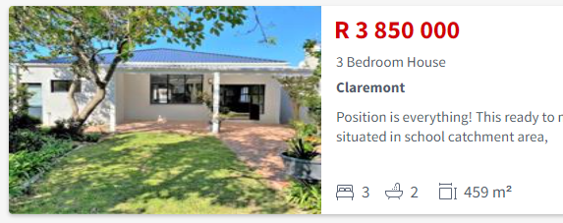
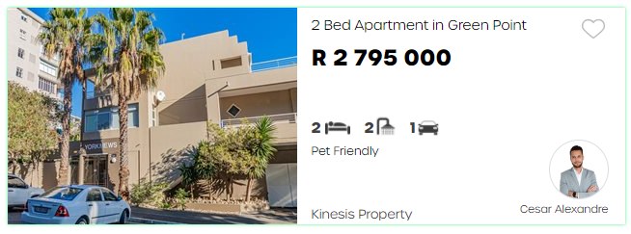
What data?
Property24
Goal: get as much data with as many features as quickly as possible
Aggregated websites (vs individual estate agents)
Extract features from the search page cards (vs opening full descriptions)
Criteria
  Residential property (exclude: commercial, industrial, farms and vacant)
  Property type: “House”, “Flat”/“Apartment”, “Townhouse”
  Location: “Cape Town”
4 vs 3 values
Same layout
PrivateProperty
SAHometraders
Notes:
First Q: finding data
Goal: much data, many features, quickly
Good way to do this = Aggregated websites – more listings, more diverse from many agents
Another good way to do this, find search result pages (many listings per page) from which could grab summaries of key feature instead of opening each listing for full description
Set some search criteria before start
Prop24 gave more key features than Private property
SAHomeTrader has similar layout – possible opportunity

Slide 4

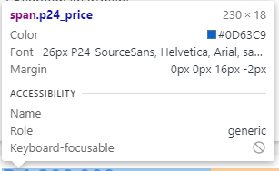
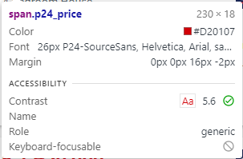


What data? Property24 vs SAHomeTraders
Property24
SAHometraders
vs
Advantages: similar html code, same information, standardised definitions
Disadvantage: duplicates
Notes:
Suspicion confirmed that Property 24 owns SAHomeTraders
Looked at the HTML code – looked similar – could be get more information without much extra effort and new code
Adv: standardised definitions eg what Cape Town is
Dis: could have more duplicates

Slide 5
Get the data
Description (type)
Price
№ bedrooms
Suburb
№ bathrooms
№ parking spaces
Floor size
Notes:
Found the HTML paths to the features
In addition to numerical values also wanted suburb and the description that contained the type of property

Slide 6
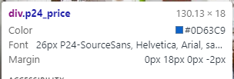
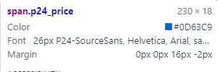
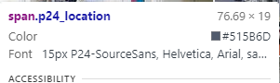
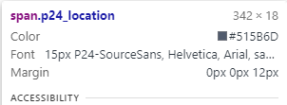
Snag with Property24
Advert of a listing on top of each page
Promoted listings as the first number of results on page 1
Promoted Listing
Standard Listing
Solution: chain on “root path” to select only main panel
selector.css('span.p24_content’).css('span.p24_location::text’)
.css ( 'span.p24_featureDetails[title = Bedrooms] > span::text')
Notes:
An anomaly on the Property 24 website: ad on top of each page; promoted listings on p1
For some of the text fields, the HTML code was different but for some it was the same
Couldn’t just fast-forward to the tag as could get mismatch between the regular listings and then partial info from promoted listings
Sol: filter down in the HTML to first select only the main panel with the regular listings and then go for the features

Slide 7
Layout of web scaper using scapy
1. Setup feature paths, empty feature variables, dataframe to hold data
2. Create manually urls for page 2 to end using list comprehension
3. Loop over urls
4. Loop over the listing cards
5. Loop over the feature locators (price, bedrooms, etc.)
["https://www.property24.com/for-sale/cape-town/western-cape/432/p{0}" \
"?PropertyCategory=House%2cApartmentOrFlat%2cTownhouse".format(i) for i in range(2, 398)]
for url in urls:
html= requests.get(url).content
for selector in root_locator:
for feature, locator in feature_package:
try:
feature = selector.css(locator).extract_first().strip()
Abandoned: automatic urls; implement in spider class
Notes:
Used the scapy package in python
Describe each step
One thing I wanted to do but abandoned was to find the next page automatically instead of hard coding the urls – but was taking too long to troubleshoot

Slide 8
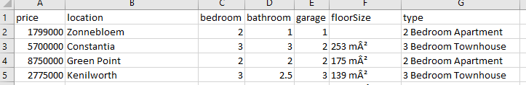
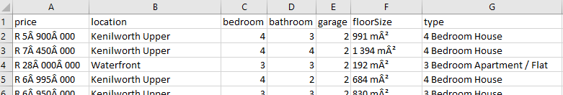
Clean the data
Property24
SAHometraders
Remove rows with missing price (target)
Remove rows with more than one missing value (abandoned: imputing)
Added under 50% of P24 to SAHome
Notes:
Then needed to clean data
Including extracting the type of property from the description – and formatting descriptions so used same terminology ie Flat = Apartment
Price = what trying to measure
Removed rows with more than one NA – because wanted to use an advanced imputing strategy that would be based on the characteristic of each observation; won’t work with many NAs per row → don’t didn’t use in end
Merged dataframe and added 50% of P24 to SAHome – 25% augmentation

Slide 9
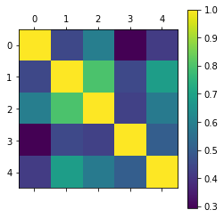
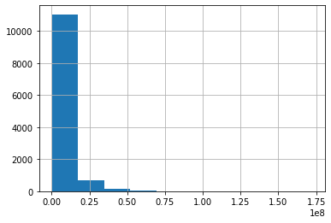
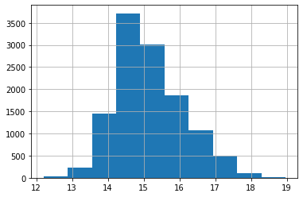
Modelling: Processing
Correlations
  Bathroom and bedrooms (0.8)
  Makes sense that scale together
  Guest toilet?
  Experimentation: better score if included
Distributions
Log Transformation
Notes:
Before modelling, examined the cleaned data
Correlation – bathroom + bedroom → could thing of a set up where houses with the same number of bedrooms but has an additional bathroom like for guests could be valued higher
ITO distributions of numerical: Data were very skewed – used log to try to get normal distribution

Slide 10
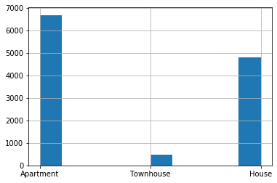
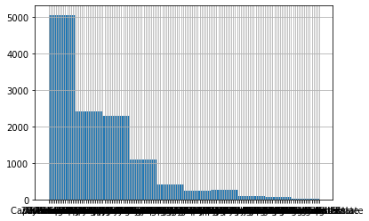
Modelling: Processing
combine
Property type
  Combine “House” and “Townhouse”
Observations per Suburb
  Remove observations that to suburb with fewer than 80 examples
  Abandoned: making higher geographical grid of suburbs
Notes:
Also looked at categorical variables
Imbalance in the property type → added town house to house
Many suburbs did not have good representation – so remove observations that belonged to suburbs with less than 80 examples
Considered summarising the suburbs on a less granular scale – but for example Greenpoint and Clifton are both Atlantic Seaboard but Clifton is definitely more swanky than Greenpoint, so I wasn’t sure about the higher-level classification and thought that suburbs very close to each other could still be priced quite differently

Slide 11
Model Building
Train (80%)/test (20%) split
Evaluate on RMSE (same units as data)
Linear Regression
Random Forest
Fundamental statistics model
Highly interpretable
CV 0.358
same for Ridge and Lasso; best alpha hyperparameter was 0
Ensemble method
CV 0.3376
best model after hyperparameter tuning with gridSearchCV
max_depth; min_samples_leaf; min_samples_split; n_estimators
Notes:
Spit data into training and hold out for final evaluation
Compared Linear regression to random forest
RF gave better CV score
Did tuning for both
LR: Ridge and Lasso and optimised alpha
RF: used gridSearch CV

Slide 12
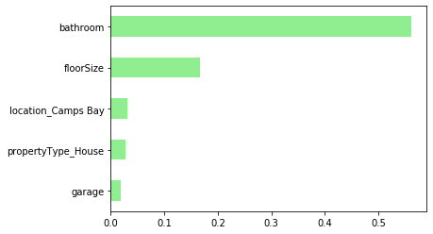
Evaluation
Prediction on hold out set:
  Linear regression: R6 408 568
  Random forest regression: R5 554 764
Comments:
  Very poor performance
  Variables not normally distributed even after log transformation – outliers; stratify train/test split on suburbs
  Features do not capture some essential driver(s) of house prices – i.e. houses with a similar number of bedrooms, bathrooms, etc. are priced very differently – scape more features
  Bruce: RMSE weighs on higher end – technical knowledge
  Linda: Online asking prices are not the real prices – domain knowledge
Random Forest Importance
Notes:
Tested final models on hold out – RF the best with a RMSE of 5.5 million rand → very poor
Some reasons/improvements:
1. some data were still not normally distributed – deal better with outliers; stratify on suburb for more representative train/test split even though removed low examples
2. a major reason could be that features don’t capture the driving factor – open up each listing for more info
As Bruce pointed out, RMSE might not be an ideal metric because weights in on the higher end
Linda also pointed out in my presentation that online vs real – even after perfect the model, the data might actually not answer the real question of valuation house prices on physical characteristics

Slide 13
What I would like to learn
Advanced string manipulation
How to make decisions for preprocessing – the right transformations based on the maths
Statistical basis on linear regression – technical knowledge
Efficient workflow – PyCharm vs Jupyter, overwriting, savings outputs
Available: https://github.com/martinjpage/DSI_houseprice
Acknowledgments: https://www.kaggle.com/apapiu/regularized-linear-models for regularised linear model regression tutorial
Notes:
Reflected on things I would like to learn going forwards
Main one if have a more efficient workflow
If I wanted to test a different processing method, would reload the data from the file, run the processing again, overwriting the previous dataframe; perform modelling and get new CV, overwriting the old one; so would need to record the CVs somewhere → could be more streamlined

